Slide 1
October 12th, 2022 General HOSA Meeting

Slide 2
Upper Chapter Board Members
President: Harmoni Stanford
Vice President: Esther Brietling Monroy
President Elect: Sama Shokr
Treasurer: Savannah Stryczny
Historian: Ena Ibrahimovic
Secretary: Grace Knauff, Abby Haber, and Jackie Youngblood

Slide 3
Committee Chairs
Competitions: Lily Pan
Celebrations: Valerie Sanchez
Philanthropy: Chase Pate & Christian Strayer
HOSA Week: Jacey Ghaly
Glam Run: Tyler Galley
Fundraising: Haley Killgore

Slide 4
Lower Chapter Board Members
President: Olivia Nguyen
Vice President: Sophia Hartley
President Elect: Jai Popuri
Historian: Rae Daniels
Treasurer: Ryla Alabat
Secretary: TBA
Parliamentarian: Briana Pate
Congratulations to our new board members!!

Slide 5
Remind
9th & 10th: @phulower23
11th & 12th: @phuupper23

Slide 6
HOSA Week
HOSA Week is a spirit week for HOSA members to celebrate our club and all things medical!!
Dates: November 7th- 11th
Themes
Monday: White out for lung cancer awareness
Tuesday: Crazy sock day
Wednesday: Crazy hair day (and scrubs/medical gear)
Thursday: Twin day
Friday: Dress like your favorite teacher

Slide 7
HOSA Week
Volunteer Opportunity
In addition to wearing all white on Monday, November 7th for lung cancer awareness, we will be passing out white ribbons for people to pin on their clothes!
We need volunteers to help make these ribbons on Friday, November 4th at 2:00pm in Mrs. Pate’s room and volunteers to pass them out Monday morning. You will be awarded 1 medical hour and 1 point for each activity.

Slide 8
Hurricane Relief Drive
Dates: October 17th – 28th
The YMCA of Suncoast is collecting supplies to help the YMCA of Southwest Florida and Collier County. We will be collecting donations through our club! Please bring any supplies to your medical teacher!

Slide 9
Hurricane Relief Drive
Acceptable Donations
Supplies: Diapers, Flashlights & Batteries, Mops, Hand Sanitizers, Fans, Cleaning Wipes, Lysol Wipes, Disposable Gloves, Mosquito Repellant
Food & Drinks: Tuna Packets, Baby Formula, Canned Goods, Rice, Pasta, Beans, Tortillas, Whole-grain Cereals, Oats, Brown Rice, 100% Fruit or Vegetable Juice

Slide 10
Regional Competition Advisor Meetings
Each person/group that is signed up for a competition MUST meet with an advisor (medical teacher) for their competition!
Our first date will be a meeting with every competitor, discussing overall competition guidelines, HOSA uniforms, and more. You will receive your specific advisor after this meeting.

Slide 11
Regional Competition Advisor meetings
Introductory Meeting: October 19th
Required Meeting 2: November 18th
Final Required Meeting: January 9th

Slide 12
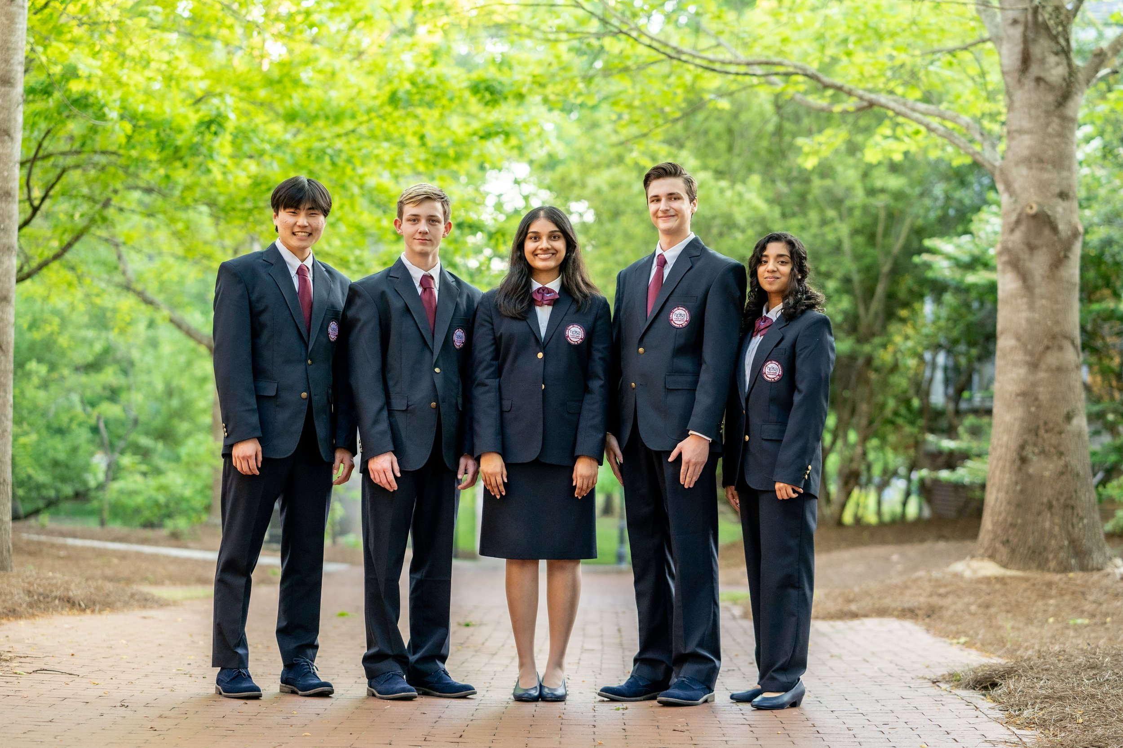
HOSA Uniform
Regional Competition
Black or Navy Blue Suit Jacket
Black or Navy Blue Dress Pants or Knee-Length Pencil Skirt
White Button-Down Long Sleeve Shirt
Maroon Tie (Men)
Black Closed-Toed Dress Shoes
Due: November 18th

Slide 13
Regional Competition
Are you interested in signing up for an event but haven’t yet? Well right after this meeting is your final chance!

Slide 14
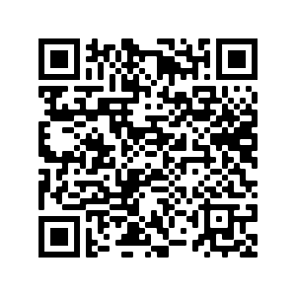
Attendance

